Slide 1

Entrepreneurship And Intrapreneurship
Made by- Jeet patel
Guided by- Disha madam
Sy-it1
En. No-160410116043

Slide 2
Definition of Entrepreneurship
An entrepreneur is an individual who conceives the idea of starting a new venture, take all types of risks, not only to put the product or service into reality but also to make it an extremely demanding one.
Entrepreneurs are always the market leader regardless of the number of competitors because they bring a relatively new concept in the market and introduce change.

Slide 3
Characteristic of Entrepreneurship
Initiates and innovates a new concept
Recognises and utilises opportunity
Arranges and coordinates resources such as man, material, machine and capital
Take suitable actions
Faces risks and uncertainties
Establishes a startup company
Takes decisions to make the product or service a profitable one
Is responsible for the profits or losses of the company

Slide 4
Definition of Intrapreneurship
An intrapreneur is nothing but an entrepreneur within the boundaries of the organisation. An intrapreneur is an employee of a large organisation, who has the authority of initiating creativity and innovation in the company’s products, services and projects, redesigning the processes, workflows and system with the objective of transforming them into a successful venture of the enterprise.
The intrapreneurs believe in change and do not fear failure, they discover new ideas, looks for such opportunities that can benefit the whole organisation takes risks, promotes innovation to improve the performance and profitability, resources are provided by the organisation.

Slide 5
The job of an intrapreneur is extremely challenging; hence they are appreciated and rewarded by the organisation accordingly.
From last few years, it has become a trend that large corporations appoint intrapreneur within the organisation, to bring operational excellence and gain competitive advantage

Slide 6
Characteristic of Intrapreneurship
Confidence
Self-starter
Creative
Determined
Passionate

Slide 7
Difference between Entrepreneurship And Intrapreneurship
entrepreneur vs intrapreneur As both entrepreneur and intrapreneur share similar qualities like conviction, creativity, zeal and insight, the two are used interchangeably. However, the two are different
an entrepreneur is a person who takes a considerable amount of risk to own and operate the business, with an aim of earning returns and rewards, from that business. He is the most important person who envisions new opportunities, products, techniques and business lines and coordinates all the activities to make them real.

Slide 8
on the contrary, an intrapreneur is an employee of the organization who is paid remuneration according to the success of the business unit, for which he/she is hired or responsible.
The primary difference between an entrepreneur and intrapreneur is that the former refers to a person who starts his own business with a new idea or concept, the latter represents an employee who promotes innovation within the limits of the organization.

Slide 9
Comparison Chart
BASIS FOR COMPARISON Meaning Approach Resources | ENTREPRENEUR Entrepreneur refers to a person who set up his own business with a new idea or concept. Intuitive Uses own resources. | INTRAPRENEUR Intrapreneur refers to an employee of the organization who is in charge of undertaking innovations in product, service, process etc. Restorative Use resources provided by the company.

Slide 10
Capital Enterprise Dependency Risk Works for | Raised by him. Newly established Independent Borne by the entrepreneur himself. Creating a leading position in the market | Financed by the company An existing one Dependent Taken by the company. Change and renew the existing organizational system and culture.

Slide 11
Similarities between Entrepreneur and Intrapreneur
Both involve large investments in the form of capital and resources.
Both focus on creation of value added products or services
Both involves risk.
Both focus on innovation

Slide 12
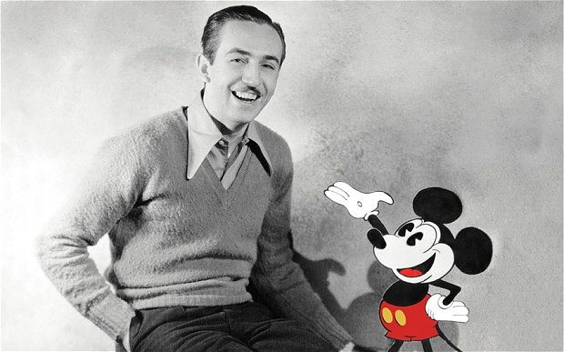
Case study Walt Disney

Slide 13
Case study
Walt Disney
Walt Disney started off as a farm boy drawing cartoon pictures of his neighbor's horses for fun. When he was older, Walt tried to get a job as a newspaper cartoonist, but was unable to find one and ended up working in an art studio where he created ads for newspapers and magazines. Eventually he grew to work on commercials, became interested in animation, and eventually opened his own animation company.
Disney's first original character creation was Oswald the Lucky Rabbit, but it was officially owned by Universal Pictures because he was working under contract at the time. When Walt walked out on Universal Pictures after getting a pay cut, he needed to create a replacement, which is how Mickey Mouse came into being.

Slide 14
Disney was wildly successful with his animation company, but he wasn't satisfied. He was determined to make the biggest and greatest theme park ever seen, saying to a colleague, "I want it to look like nothing else in the world."
One of the biggest entertainment moguls of all-time, with an unrelenting spirit and commitment to his vision, Disney is undoubtedly an entrepreneurial all-sta

Slide 15


